Slide 1
Project Phase 1
Project Title: Crowdsourced Travel Guides and Travel Itineraries
Group C – 1
Members:- Rachit Patel
Himil Prajapati
Aditya Upadhyay

Slide 2
Project Scope and Objectives
Project Scope
Crowdsourced reliable travel guides, that can be created and reviewed by users. Along with a platform for travel agents to sell travel experiences. Giving users the ability to interact and share reliable information about travelling.
Project Objectives
To provide a platform for users to write, read, discuss and share informative and reliable guides for travel destinations, events, activities and staycations.
Along with a reliable place for buying vacation packages and activities from agents.
Give users the ability to hire guides for tours.
Giving users the ability to rent houses or apartments.
Providing a way to communicate between users through messaging system in the website.
Allow users to gather and make their own travel activities.
Post video blogs.

Slide 3






Technologies being used
Front End
HTML
CSS
JavaScript
React.js
Back End
Node.js
MongoDB

Slide 5
Technologies being used
HTML – HyperText Markup Language
HyperText Markup Language is used to design documents to be displayed in a web browser.
It consists of a set of tags and attributes, that define how the content of a website should be seen in a web browser.
It provides the basic structure of a website.
CSS (Cascading Style Sheet) can be used along with an HTML page, to leave the designing of various components to CSS exclusively and hence reducing the clutter in code.
Additionally HTML pages can include reference to JavaScript code which can provide added functionality to the website.

Slide 6
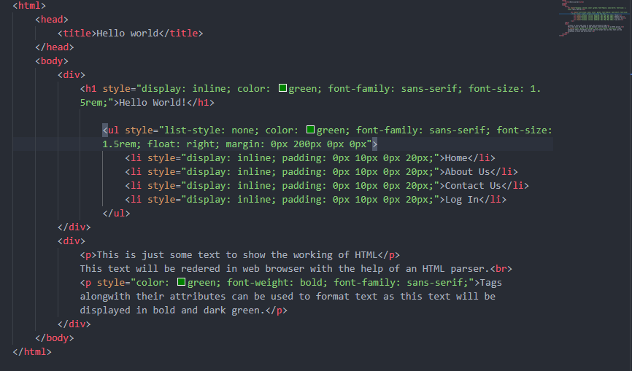
Technologies being used
HTML

Slide 7
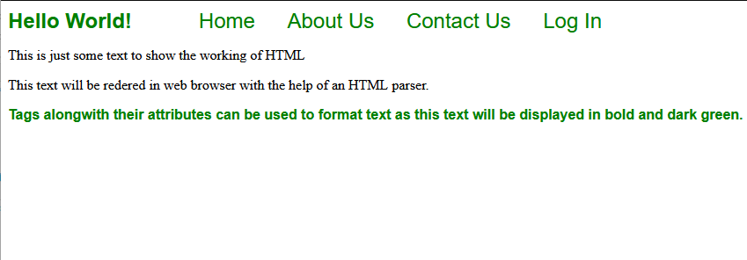
Technologies being used
HTML
The code used to create this output becomes very cluttered to solve this problem, we use CSS.

Slide 8
Technologies being used
CSS – Cascading Style Sheet
.css file can be cached to improve the page load speed between the pages that share
file and its formatting.
The name cascading comes from the specified priority scheme to determine which style rule applies if more than one rule matches a particular element.
It can be used inline, internally or externally.
We can link an html file with a css file and reduce the clutter in the html code as shown in the next slide.

Slide 9
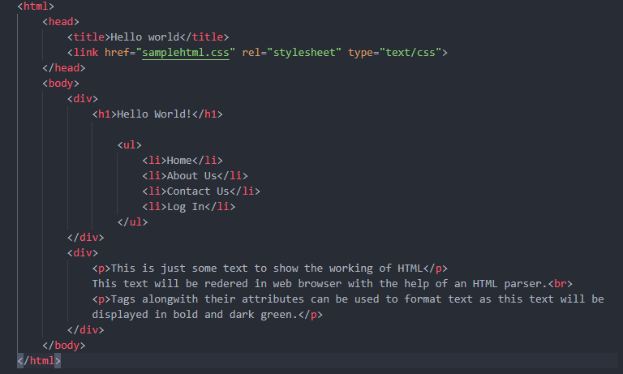
Technologies being used
CSS – Cascading Style Sheet

Slide 10
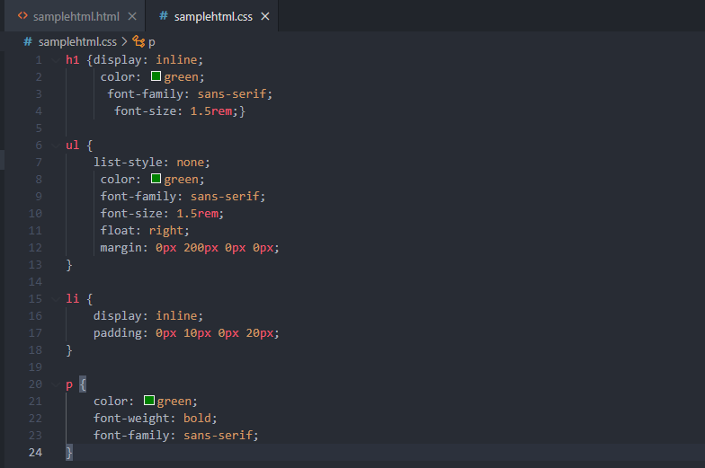
Technologies being used
CSS – Cascading Style Sheet

Slide 11

Technologies being used
JavaScript
JavaScript is a high level programming language that conforms to ECMAScript specification.
It is used to make a webpage dynamic. For e.g. Including animations, validating input values from a web form.
It is the dominant client-side scripting language of the web.
Scripts are embedded or included from HTML documents and interact with the DOM(Document Object Model).
All web browsers have a built-in JavaScript Engine that executes the code on the user’s device.
It can be used along with third party JavaScript library or web framework.
For e.g. Facebook created React library for it’s website and is now open source.

Slide 12
Technologies being used
React.js
Front end JavaScript library for building user interfaces or UI components.
React is only concerned with state management and rendering the state of the DOM.
React code is made of entities called components. Components can be rendered to a particular element in the DOM using the React DOM library. When rendering a component, one can pass in values that are known as “props”.
Virtual DOM
Instead of changing the entire web page for each change, React libraries only render subcomponents that actually change.
This provides an increase in performance as it saves effort of rendering the layout for the entire page.

Slide 13

Technologies being used
Document Object Model
Document Object Model (DOM) is an interface that treats an XML or HTML document
as a tree structure wherein each node is an object representing a part of the document.
When a web page is loaded, the browser creates a Document Object Model of the page, which is an object oriented representation of an HTML document that acts as an interface between JavaScript and the document itself.

Slide 14
Technologies being used
Node.js
Node.js allows JavaScript code to be executed outside a web browser.
It creates a JavaScript runtime environment in the backend using the open-source JavaScript engine (V8 engine) present in Google Chrome browser.
Developer can use JavaScript for server-side scripting to produce dynamic web page content before the page is sent to the user's web browser.
npm – node package manager makes it easier to install , update and uninstall packages.
The most significant difference between Node.js and PHP is that most functions in PHP block until completion (commands execute only after previous commands finish), while Node.js functions are non-blocking (commands execute concurrently or even in parallel.
Node.js brings event driven programming to web servers, enabling development of fast web servers in JavaScript.

Slide 15
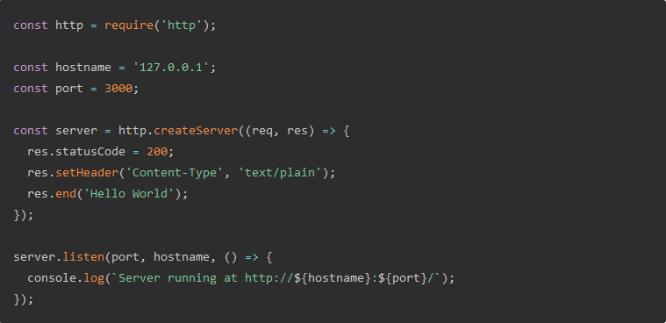
Technologies being used
Node.js

Slide 16
Technologies being used
MongoDB
NoSQL database program that stores data in the form of documents.
The data is stored in JSON – JavaScript Object Notation format.
As data is not stored in relational format it is easier to insert and retrieve information in NoSQL databases.
Queries can be written in JSON format.
Also provides a GUI know as compass making it easier to view data and perform CRUD (Create, Read, Update and Delete operations).
Documents are addressed in the database via a unique key that represents the document.
A group of Documents is called a Collection.

Slide 17
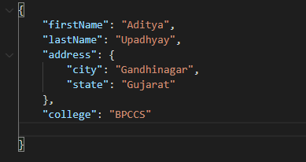
Technologies being used
JSON
JSON is a data interchange format that uses human-readable text to store and transmit data objects consisting of attribute-value pairs.

Slide 18
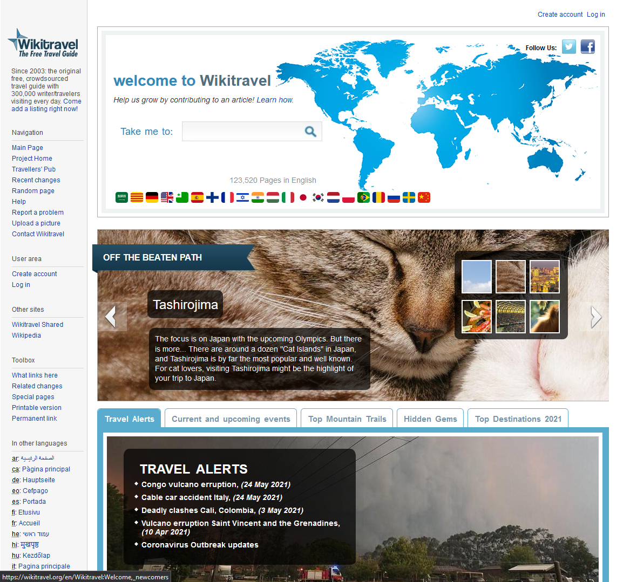
Study of existing system
WikiTravels
Since 2003, WikiTravels hosts original free, crowdsourced travel guide with 300,000 writers/travelers visiting each day.
Provides guides in multiple languages.
Also shows featured travel locations and interesting new and unknown places to go to.

Slide 19
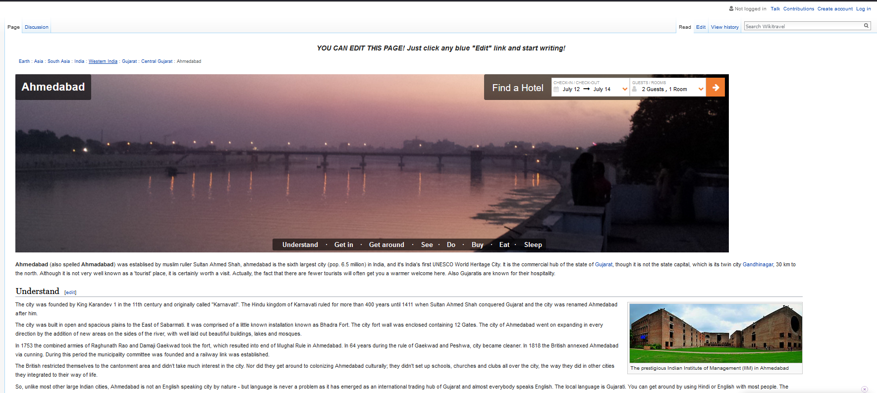
WikiTravels
Has guides with images, a hotel room finder and links to certain sections of the guide. For E.g. Get around, See, Do, Buy, Eat etc.
Gives a format for writing guides, which makes it’s easy for new writers to structure content.
Also provides links to Wikipedia pages for more information.

Slide 20
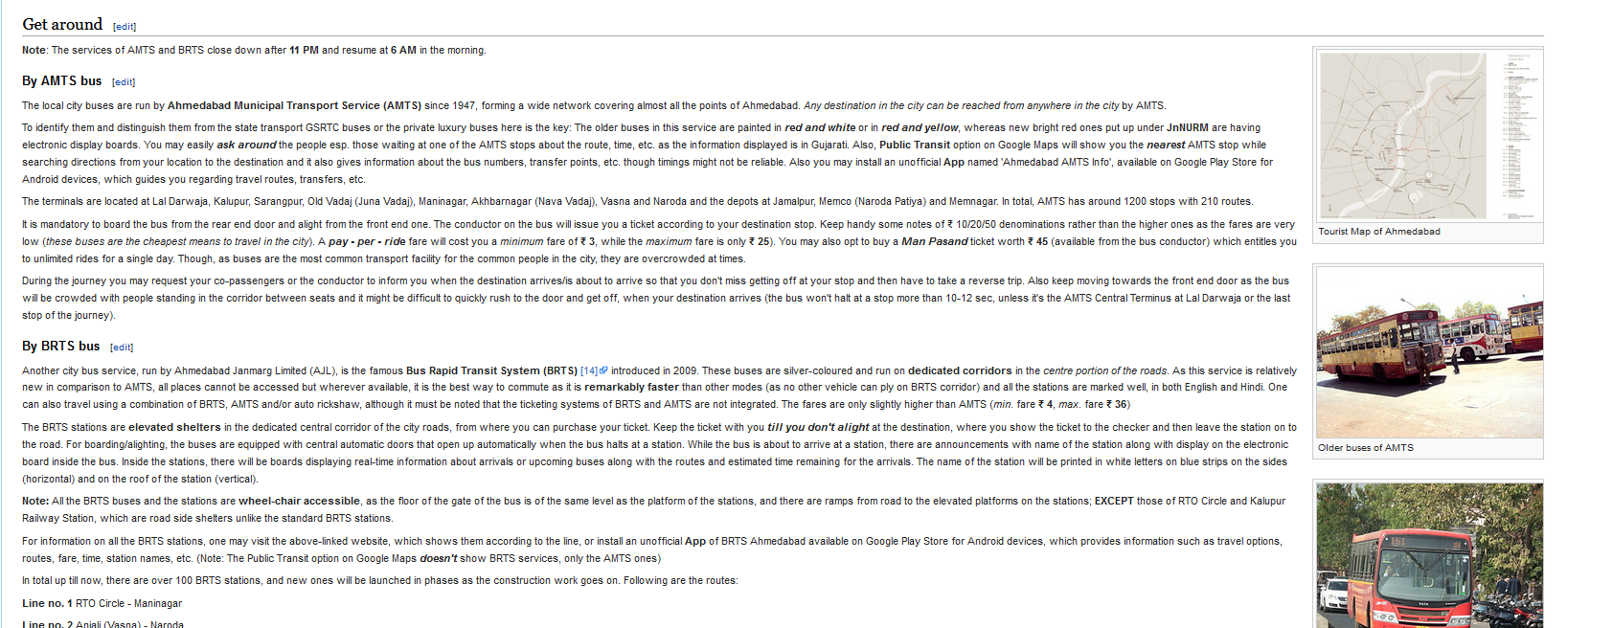
WikiTravels
Provides information about bus or metro routes along with travel fare.
Anyone can update the guide with relevant information at any time.
Any new edit has to be confirmed by a moderator team.
In some cases where a moderator is not available for review, clear warnings are given about the information in the guide.

Slide 21
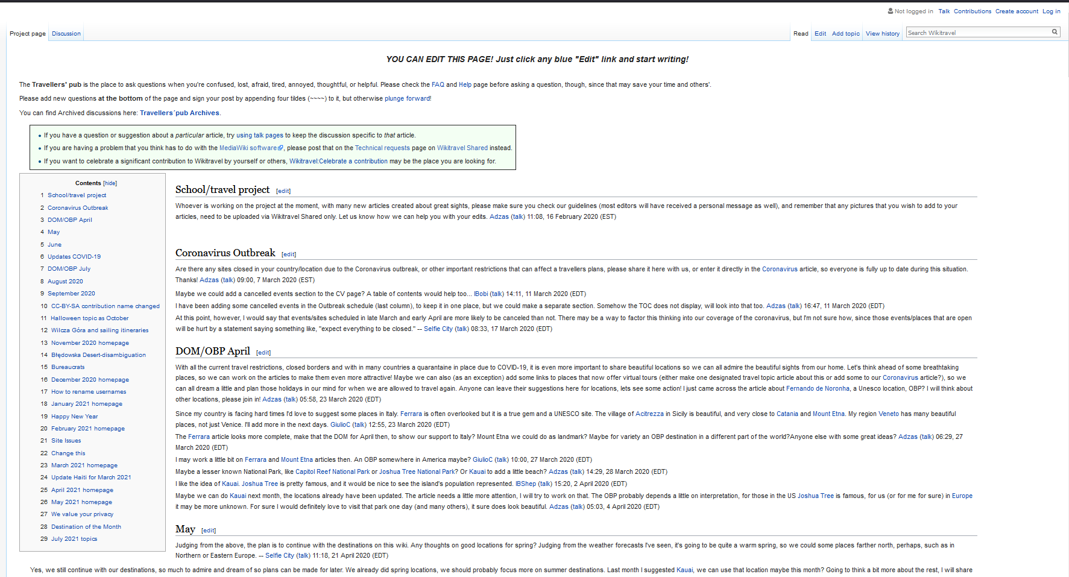
WikiTravels
Traveler’s pub is a place where, users can share their views about the next place to be featured.
Users can also share information with each other regarding any travel hazard in their areas.
Users can nominate other writers for their effort.

Slide 22
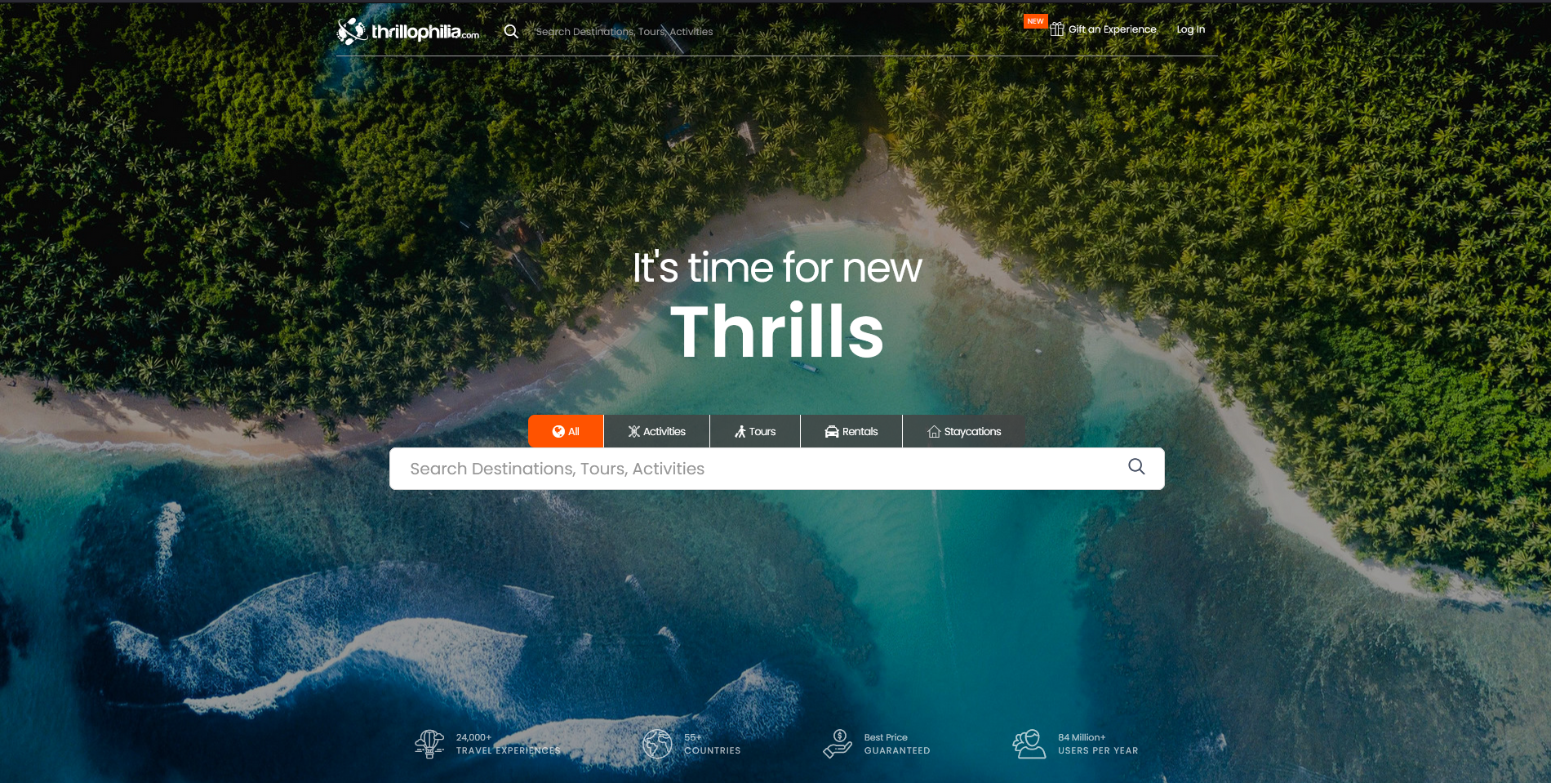
Thrillophilia
Commercial website catering to people looking for activities, tours, rentals and staycations for low prices. 84 million+ users per year, 55+countries.
Offers a more simple user interface and better design.

Slide 23
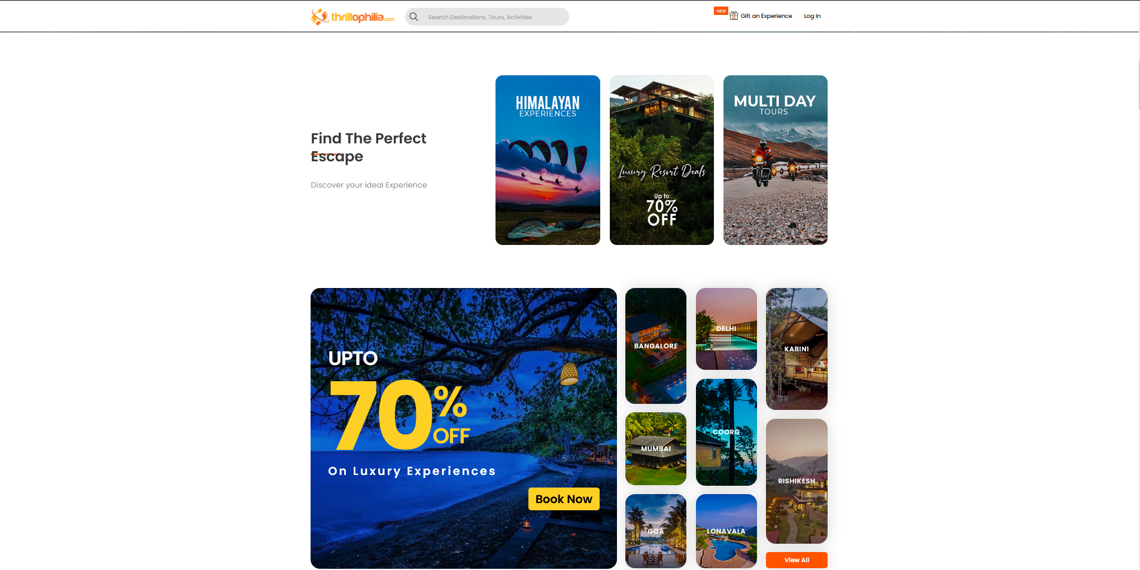
Thrillophilia
Showing various travel locations as multimedia cards.

Slide 24
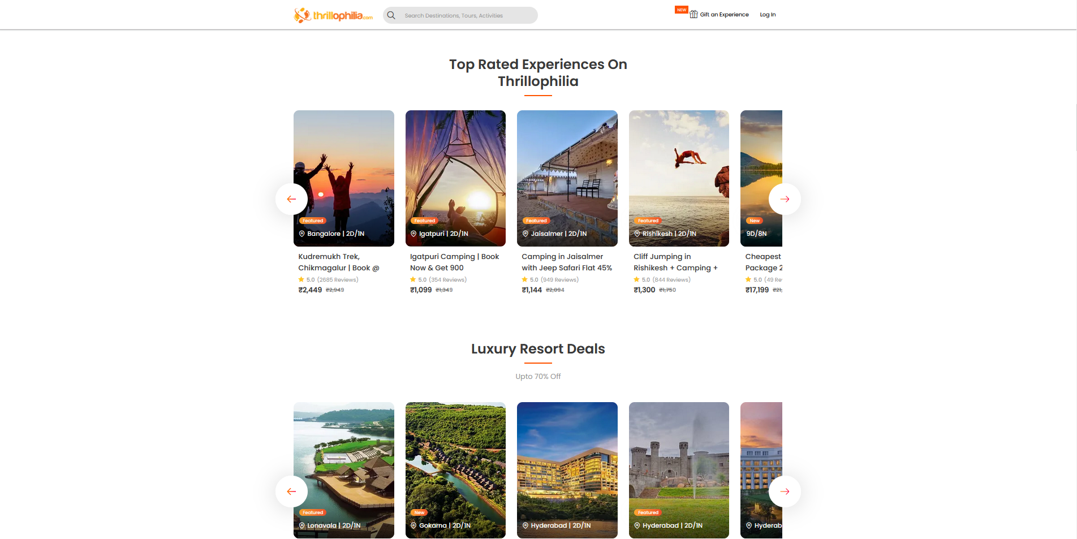
Thrillophilia
Users can see various travel packages along with prices, discounts, user reviews and ratings.

Slide 25
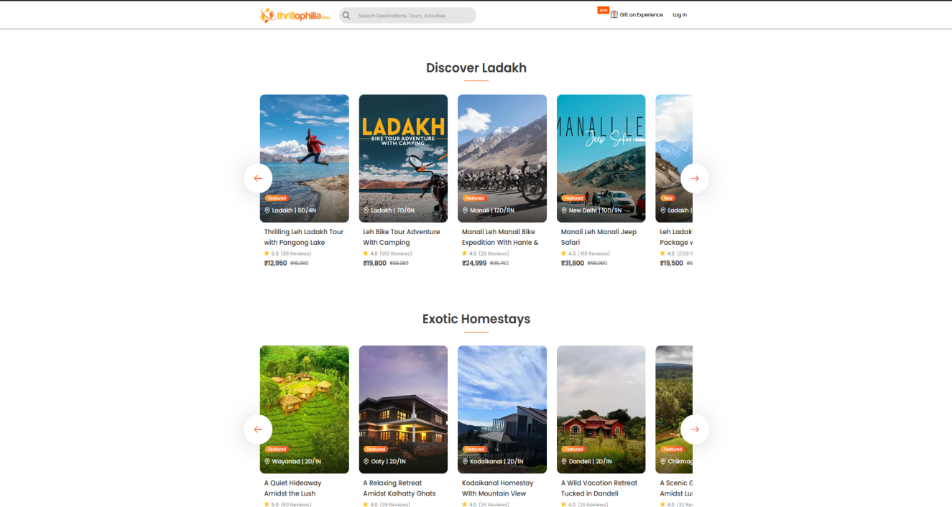
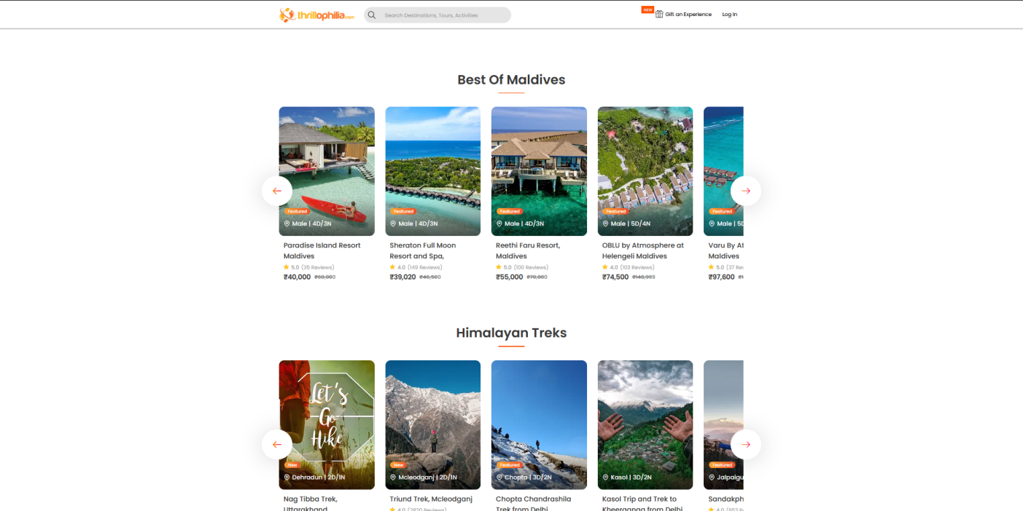
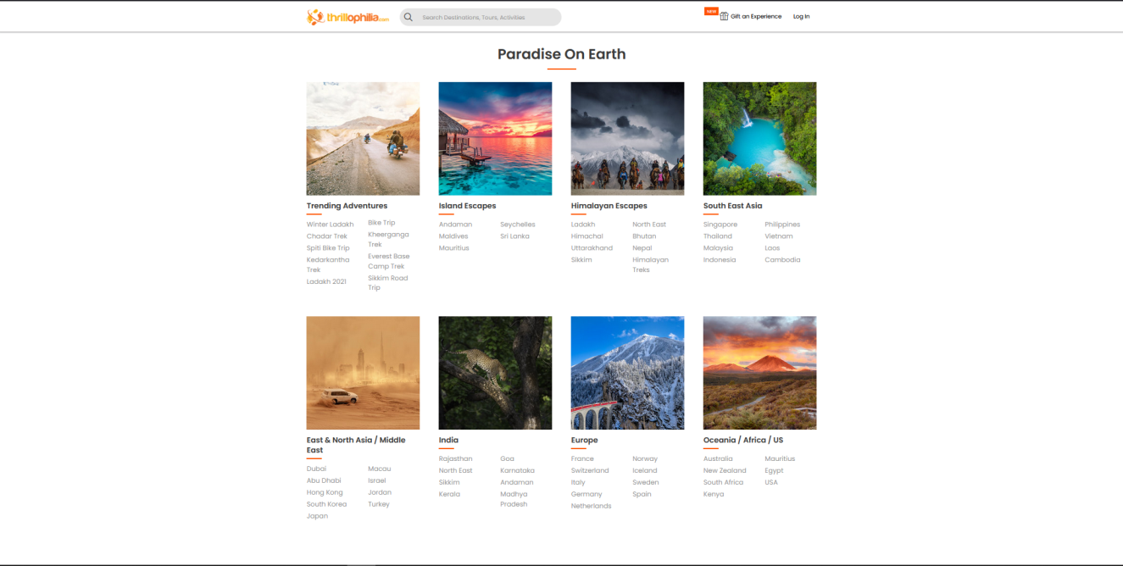
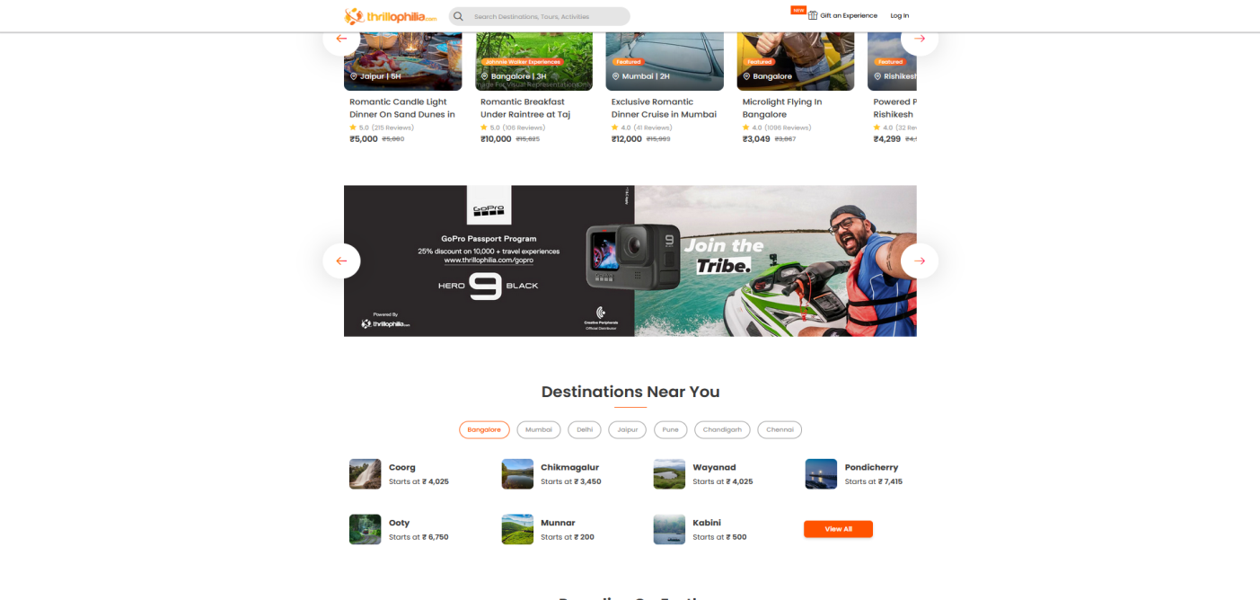
Thrillophilia

Slide 26
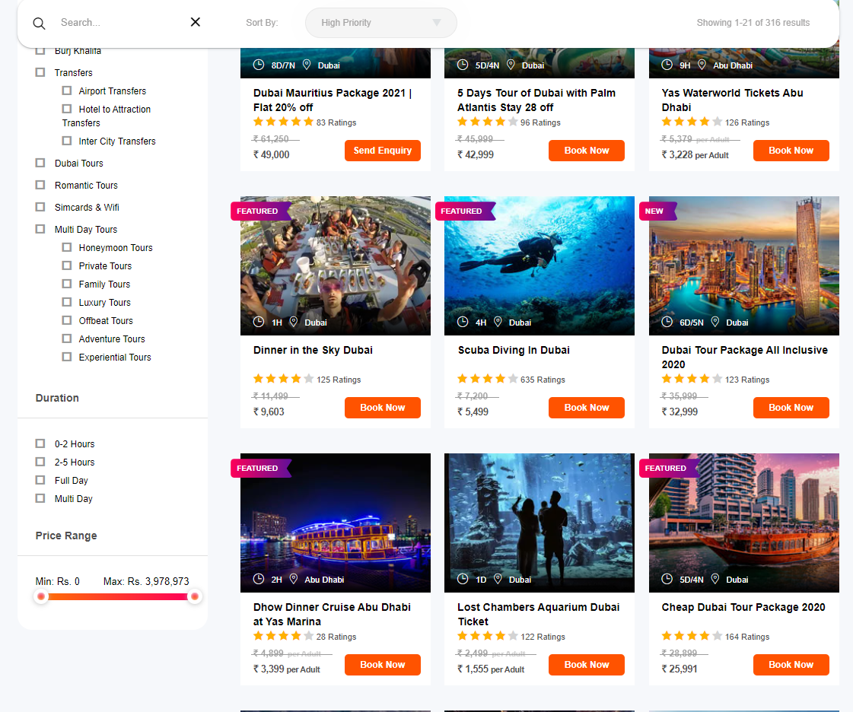
Thrillophilia
Provides tools like price range selector, location selector, user rating range to find the best travel location for you.

Slide 27
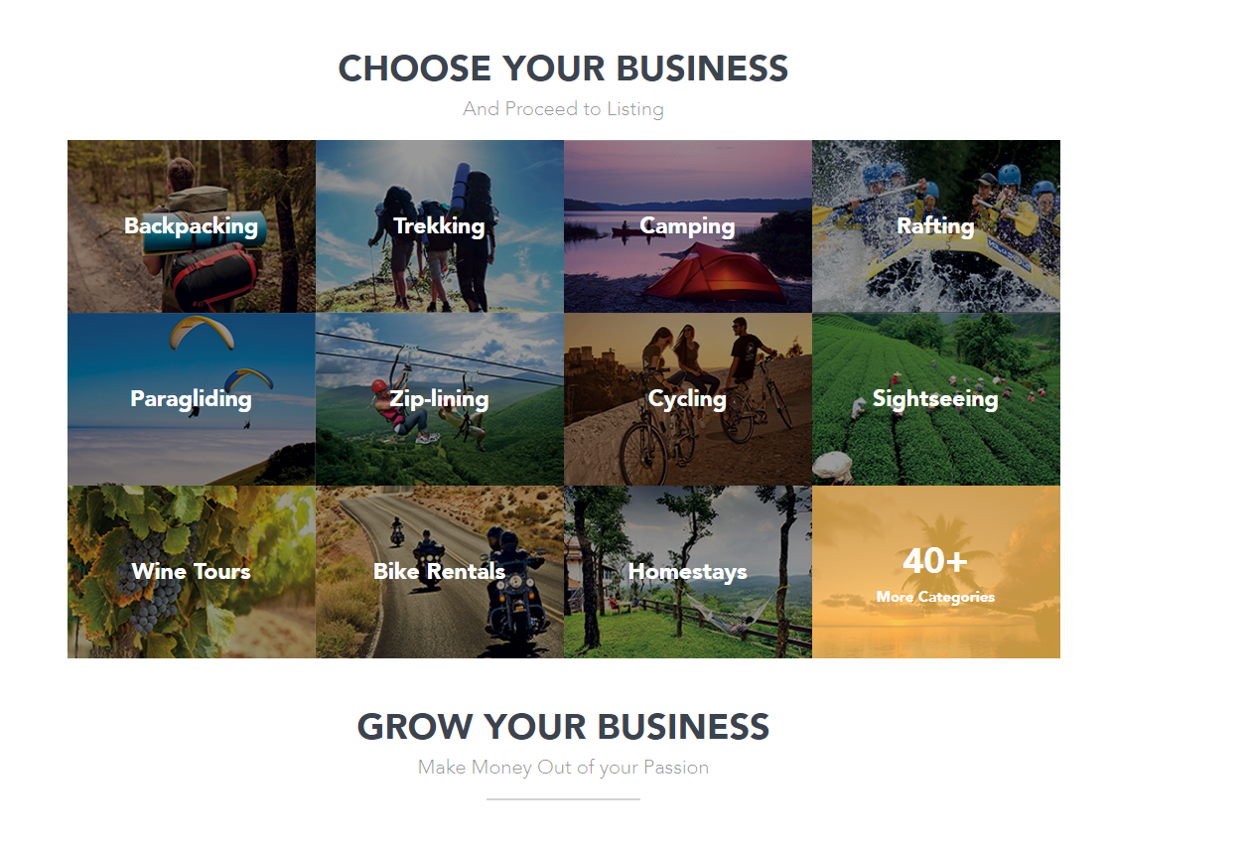
Thrillophilia
Travel agents and suppliers can easily list their services and packages on the website and get new customers.

Slide 28
Advantages and disadvantages of existing system
WikiTravel
Advantages
More trust in travel information as writers do not have any financial incentive for writing guides.
Ease of getting information from all parts of the world.
Useful for people who wish to read the various travel guides and make their own travel plans.
Active group of moderators can monitor and remove posts that do not meet various guidelines.
Gives people a sense of being a part of a larger community of travelers.

Slide 29
Advantages and disadvantages of existing system
WikiTravel
Disadvantages
Lack of any commercial services makes it difficult to cover the costs of running servers and storing data.
Poor user interface design.
Lack of a proper rating system.
Lack of a proper forum for user discussions.
Places large responsibility on independent moderators to monitor various edits and posts.
Lack of information regarding hotel room and flights availability.

Slide 30
Advantages and disadvantages of existing system
Thrillophilia
Advantages
Attractive design and user interface helps attract customers.
Can generate good revenue due to the highly commercial nature of the website.
Good for attracting users who want ready made travel packages along with brief descriptions and images.
User rating system to easily find out the best deals.
Provides an easy to register and sell, interface for travel agents and suppliers.

Slide 31
Advantages and disadvantages of existing system
Thrillophilia
Disadvantages
Does not have the crowdsourced travel information features of WikiTravel.
No availability of information for plane, train or bus route or fares.
Requires a dedicated staff to curate and categorize the content on the website.

Slide 32
Operational level problems
Incomplete or inaccurate information provided by users.
Fake accounts increasing rating.
Lack of organized structure in decision making.
Travel agents posting fake deals.
Responding to user complaints for wrongful deals.

Slide 33
Technical level problems
Providing enough server hardware to handle requests from large number of users from around the world.
Integrating a payment method that sends money to travel agents after making the required deduction for providing our services.
Maintaining a large database with the capacity to store and retrieve user’s image, text and other details.
Creating admin/staff/moderator accounts that can take necessary action in certain cases.
Securing user’s data against cyber attacks.

Slide 34
Informational level problems
Getting accurate information about hotel bookings, flights, train and bus fares and routes.
Verifying information that is being submitted.
Deleting content that has been posted a long time ago.
Getting information to cross check content.

Slide 35
ER Model (Chen’s model)
Name
Username
Name
Customer rating
Payment Gateway
Email id
Transacts
Payment details
Transacts
User
Travel agent
Reviews
Travel Locations
Details
Posts
Edits
m
Offers
Price
Makes Complaint
Books
m
Travel Package
m
Offers
m
Validates
Writes
Travel Guide
Checks
Moderator/Admin
Location
Edit history
Upvote/downvote
Admin ID
Privileges
Complaint
Validates
Complaint ID

Slide 36
Checks
Date of creation
User review
Information provider
Writes
Rating
Location
User ID
Shares information
Rating
IP_name
Staff Content writer
S_ID
S_Name

Slide 37
Proposed System
A website that allows people to create an account and share trustworthy information related to traveling to various places.
Allows people to book travel packages.
Write useful reviews for the benefit of other people.
Allow users to discuss about traveling.
Allow travel agents to sell their products and services.
Allow users to hire guides.

Slide 38
Proposed System – Advantages
Get trustworthy travel related information and packages at the same place.
Buy airline and railway tickets.
Hire knowledgeable guides.
Enhance your knowledge by conversing with other users.
Get user reviews about various packages to help with decision making.
Get paid for providing content.
Sellers can get a large target audience to sell to directly.
Ease of posting products and services.

Slide 39
Proposed System – Disadvantages
Requires a dedicated team to monitor content.
Requires constant updates with travel information.
Web server infrastructure needs to be scaled in case of large number of users uploading content.
Requires group of experts to cross check information.
Needs quick addressable system for customer grievances.
Requires the website to be immune to cyberattacks that can lead to leak of private user data.

Slide 40
System Requirement Specification
A system requirement is a characteristic or feature that must be included in an information system to satisfy business requirements and be acceptable to users.
These fall into five categories : -
Output Examples
The website must be able to display dynamically updated content.
The website must produce alerts for staff members.
Reports should be generated about malpractice by sellers.
Complaints should be generated against users not adhering to terms and conditions.
Input Examples
Complaint page should provide a uniform design with the ability to give a written description.
Staff members should be provided access to specific pages according to their roles and responsibilities.

Slide 41
System Requirement Specification
Process Examples
In case of payment in foreign currency the system must be able to carry out the transactions at the prevailing exchange rate.
System must carry out the process of users booking tickets for bus, train , airplane etc with third parties.
System must be able to process information to produce relevant reports for staff.
Performance Examples
Response time must not exceed 6 seconds.
System must be operational seven days a week and 365 days a year.
The system must generate revenue reports at the end of each day.
The system must be able to generate complaint reports for staff within 15 minutes.

Slide 42
System Requirement Specification
Control Examples
The system must maintain separate level of security for users and the system administrator.
All transactions must have a system to audit them.
System must create an error log file that includes the error type, description, and time.

Slide 43
System Requirement Specification (SRS)
Functional Requirement
Core -i3 processor 2.4Ghz clock speed
2GB RAM
Any modern web browser capable of handling multimedia content.
A virtual private server provider. (E.g. Digital ocean, linode, AWS, google cloud platform, godaddy).
A cloud data server provider that can be used to store data. (E.g. AWS’s S3 bucket).
Non-Functional Requirements
The database must meet industry guidelines.
Sellers shall be prompted to provide authentication in the form of government id proof.
People who want to be listed as guides need to undergo checks from the staff.
Users should have the ability to control private data collection by us.
Users should have the ability to control the nature of cookies used by the website.
Most of the processes must get automated.

Slide 44
Feasibility Study (Operational Feasibility)
Availability of accurate information from users.
The website should meet the expectations of the users in terms of content quality, seller authenticity and ease of payment.
Users should find the website easy to navigate and find deals of their interests.
Additional facilities like guide hiring, bus, train and plane ticket booking , and travel routes must work to users expectations.

Slide 45
Feasibility Study (Technical Feasibility)
A virtual server capable of handling large number of requests from clients.
A database capable of storing, querying and sending large amounts of information.
Ensuring the website does not have security vulnerabilities.
Availability of information from third parties E.g. API’s.
Ability to scale up during user growth and acquire additional hardware.
Ability to convert data from third parties into data storage compatible form.

Slide 46
Feasibility Study (Economic Feasibility)
Cost incurred by using a virtual server.
Cost of buying a domain name.
Cost of buying a 3rd party payment gateway.
Cost incurred from obtaining information from 3rd party sources.
Cost incurred by scaling up and using more hardware resources.

Slide 47
Proposed system modules
User Module
Admin/Moderator Module
Travel Agent Module
Developer Module

Slide 48
Data Dictionary

